Slide 1
General characteristics of the Bryophytes, Lycopodium, Horsetails

Slide 2
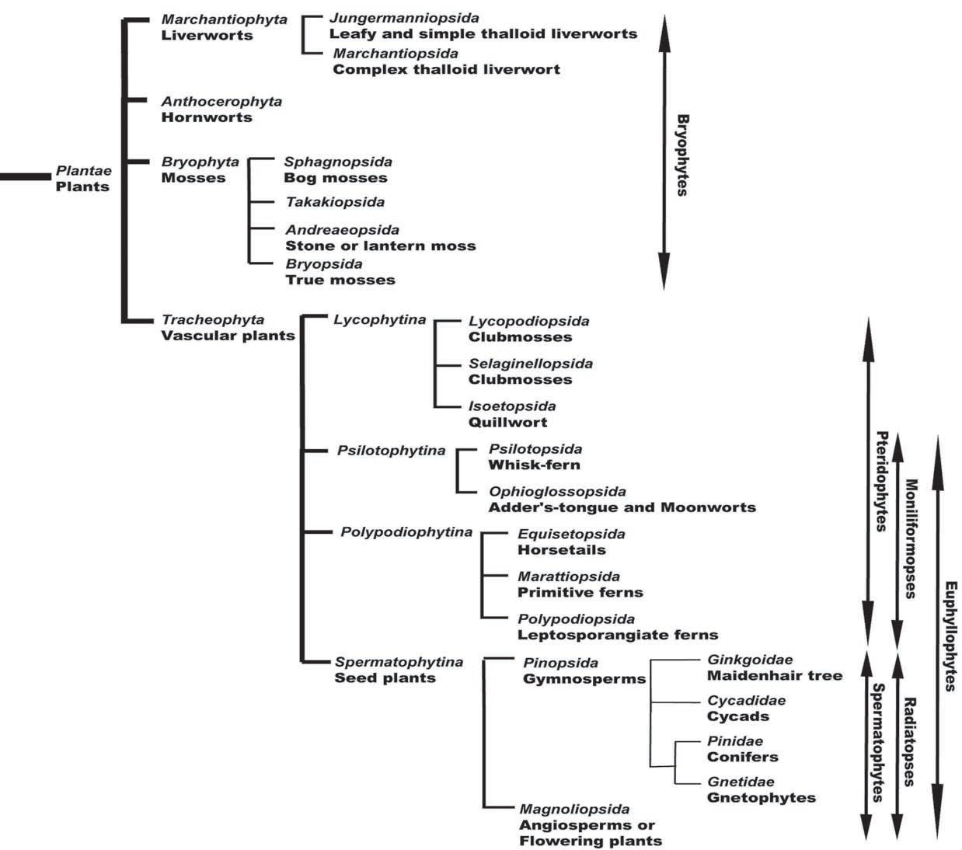
Kingdom Plantae or subkingdom
Embryobionta: PLANTS
Bryophytes and tracheophytes are monophyletic (one branch of the evolutionary tree of life) and collectively called embryophytes. As the name implies, there is an embryonic stage in these organisms as contrasted with their closest relative green algae.
A phylogenetic arrangement of living plants.

Slide 3
Another feature that distinguishes plants from almost all algae is the presence of complex reproductive organs, the archegonium, antheridium and sporangium.
Other shared features of plants include the following:
haplodiplobiontic life cycle and multicellular sporophytes;
sporopollenin in the spore wall (also detected in some algae);
cuticle (waxy outer layer of the epidermis).

Slide 4
Bryophytes (mosses, hornworts, and liverworts) can be found in all ecosystems of earth. The diversity increases at tropical and subtropical latitudes. Another term commonly used for this group is nonvascular plants. Bryophytes lack xylem and phloem, the conductive tissues of vascular plants (=tracheophytes).
All embryophytes have a life cycle that involves an alternation between sporophyte and gametophyte generations.
In vascular plants it is the sporophyte is the dominant, obvious stage; the grasses, flowering trees, ferns, and conifers we admire are all sporophytes. The sporophyte is the generation that produces the spores that will develop into the inconspicuous gametophyte stage (multicellular product of the germinated spore). The gametophytes are tucked away and out of sight.

Slide 5
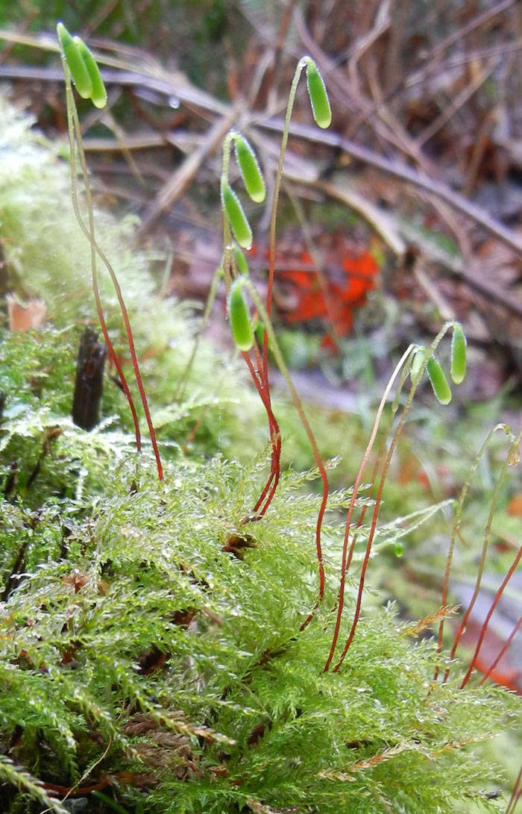
Bryophytes, on the other hand, have a conspicuous gametophyte stage (in most cases) that forms the green mats and tufts we see. Unlike tracheophytes, it is the gametophyte stage that is conspicuous and composed of either stem and leaves or flattened ribbon-like thallus. The leaves of bryophytes are structurally very different from those of tracheophytes; they are generally one cell layer thick! The sporophyte of bryophytes is dependent on the gametophyte for water and nutrients and in most cases conspicuous (as you can see in the image of Leucolepis acanthoneuron to the left).
The sporophyte consists only of a capsule (sporangium) on an unbranched stalk (seta). In contrast the vascular plants have a sporophyte that is independent of the gametophyte, with sporangia produced on a branched stem.
Leucolepis acanthoneuron

Slide 6
Most of Bryophytes have a limited ability to control their water content (poikilohydric). The vascular plants are characterised by a well-developed ability to control their water content (homoiohydric) with the possession of a specialised xylem tissue for transporting water.
Some species of mosses and liverworts have hydroids that are analogous to the tracheids of vascular plants but moss hydroids have smooth, not unevenly thickened, walls, thinner than that in tracheids. Perforated water conducting cells are present in the moss Takakia and are also found in the thallus of some thalloid liverworts.
Bryophytes lack roots but have rhizoids, elongated cells that penetrate the soil. These are a general feature of plants although they have been lost from some more specialised plants. They differ from roots in their simplicity; they are mainly unicellular or, if multicellular, they are usually uniseriate.

Slide 7
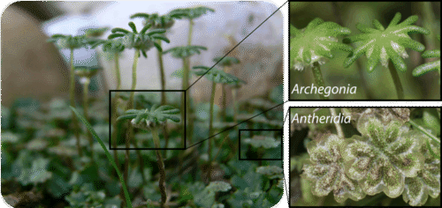
Life cycle of mosses is similar to the general life cycle of land plants. They begin with a gametophyte with an archegonia and antheridia.
Female gametangia is called archegonium, the male gametangia—anteridium.
The archegonium produces oocyte which is fertilized by the anteridium’s spermatozoon in the process of oogamy.
The antheridium of mosses produces biflagellate spermatozoa which fertilizes the egg and produces diploid zygote; zygote grows into a sporogon and its cells (mother cells of spores) go through meiosis which produces haploid spores.
The reproductive organs of Bryophytes like this liverwort are male antheridia and female archegonia.

Slide 8
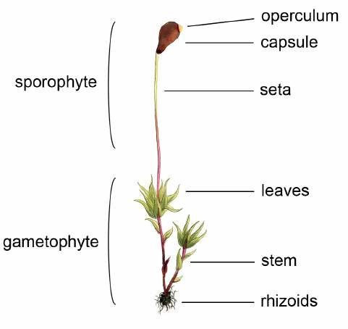
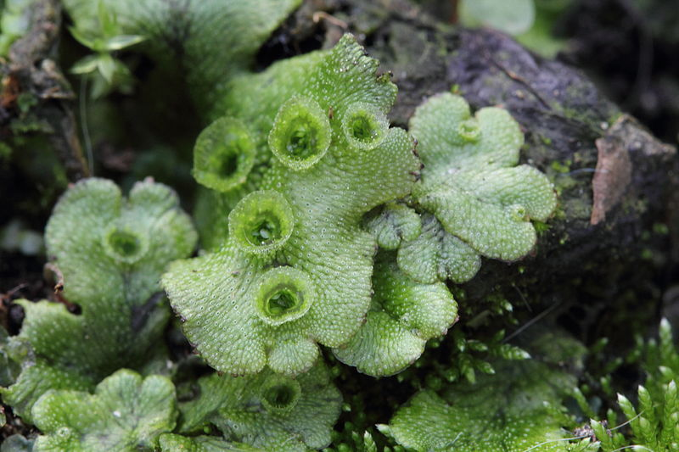
Most of moss gametophytes have a shoot body that consists of a stem and leaves (but no roots)
while others have a thallus body, which is a flat, leaf-like, and undifferentiated structure.

Slide 9
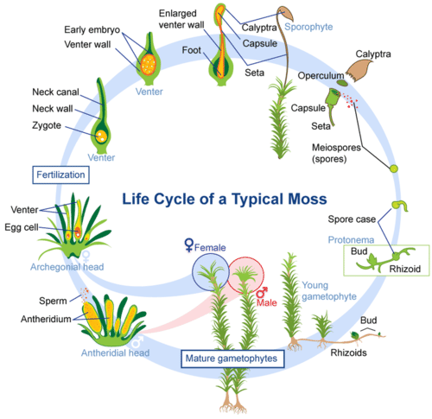
The life cycle of most mosses begins with the release of spores from a capsule, which opens when a small, lidlike structure, called the operculum, degenerates. A single spore germinates to form a branched, filamentous protonema, from which a leafy gametophyte develops.
The gametophyte bears organs for sexual reproduction. Sperm, which are released by the mature antheridium (the male reproductive organ), are attracted into the neck of an archegonium (the female reproductive organ). Here, one sperm fuses with the egg to produce the zygote.
After cell division, the zygote becomes the sporophyte, and, at the same time, the archegonium divides to form the protective calyptra. The sporophyte usually consists of a capsule and a seta.
Asexual reproduction occurs within the capsule and the whole process may begin again.

Slide 10
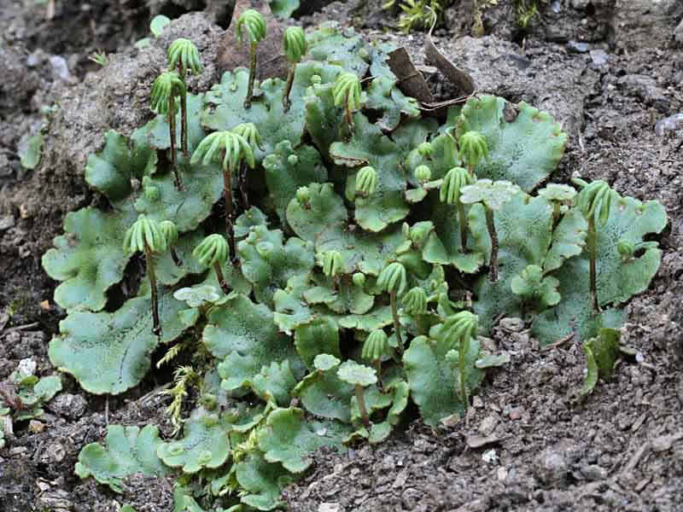
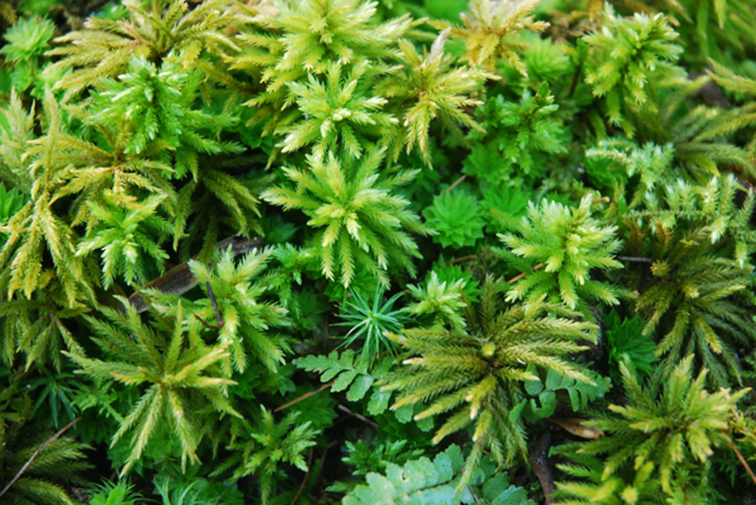
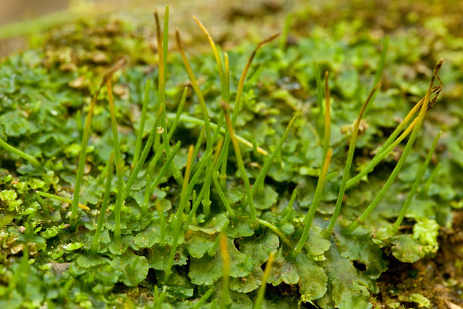
Bryophytes include three lineages :
Phylum Marchantiophyta – Liverworts (Hepaticophyta), (approximately 6,000 species worldwide)
Phylum Bryophyta – Mosses (Bryophyta), (approximately 12,800 species worldwide)
Phylum Anthocerotophyta – Hornworts (Anthocerophyta), (approximately 150 species worldwide)
Liverworts
Mosses
Hornworts

Slide 11
Phylum Marchantiophyta
Phylum Marchantiophyta are commonly known as the “liverworts” due to the shape of hepatic liverworts resembling the shape of the liver. According to an old medical doctrine, this resemblance indicated liverworts could cure illnesses of the liver.
Liverworts are located on nearly every continent, inhabiting a diverse array of ecosystems. They may be found in harsh environments that many organisms find difficult to live and reproduce, however liverworts are not generally found in salty aquatic environments such as the ocean.

Slide 12
The morphology of the free-living gametophytic generation varies within Marchantiophyta. There are many forms of gametophyte ranging from thalloid to leafy, and large to small. The isodiametric cells of the gametophore typically have oil bodies.
The oil bodies are true membrane-bound organelles that vary in size, shape, number, color, and chemical composition among species. When liverworts are dried (such as for storage in a Herbarium) the oil bodies degrade at varying rates over time. The function of oil bodies is currently unknown, but they may serve to deter herbivores or aid in protection from the cold or UV rays.
There is not a well-developed conducting system. Rhizoids are smooth and unicellular and serve to anchor and conduct water and minerals.

Slide 13
The 2000 classification divides the liverworts into two classes: Marchantiopsida and Jungermanniopsida.
All the complex thallose liverworts are in the former and all the leafy liverworts in the latter.
The precise definitions of the two classes are based on a number of microscopic morphological features. The class Jungermanniopsida is much, much larger than Marchantiopsida. The leafy liverwort species far outnumber the thallose species.

Slide 14
The 2000 classification divides the class Marchantiopsida into two sub-classes: Marchantiidae (complex thallose) and Sphaerocarpidae (simple thallose).
Within the sub-class Marchantiidae the bulk of the complex thallose liverworts are placed in the order Marchantiales. The order derives its name from the genus Marchantia (family Marchantiaceae) and the thick, somewhat leathery thalli of the species in this genus are well-known to many people.

Slide 15
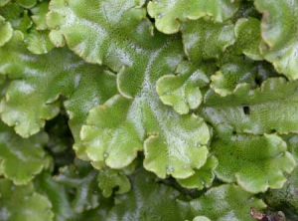
Class Marchantiopsida
The species in the class Marchantiopsida are characterized as being complex thalloid liverworts. They have a global distribution and are commonly found growing on moist earth or mud. A few species can also be observed growing in water. The gametophore of the species in this class is always thallose.
The thallus, which is generally several cell thick, typically exhibits dichotomous branching.
The differentiated tissues of the thallus is why species in this class are termed the “complex thalloid liverworts”, and in turn, it distinguishes them from the simple thalloid liverworts seen in the class Jungermanniopsida.
The dichotomous branching thallus

Slide 16
The internal differentiation of the thallus can be made apparent due to the presence of several distinct tissues.
The upper surface (dorsal) of the thallus is composed of an epidermis. The cells forming the epidermis contain no or very little chlorophyll. Furthermore, the epidermis of most genera in this class has pores, which can either be simple or complex, that serve as an opening to the photosynthetic tissue in the air chambers beneath. Unlike stomata seen in higher plants, simple pores of these thalloid liverworts cannot open and close.

Slide 17
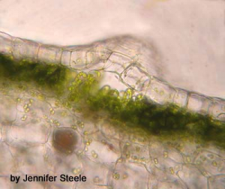
As previously mentioned, these air chambers house the photosynthetic tissue.
The chloroplasts are typically located in the cells that make up the walls of these chambers or in uniseriate filaments found growing on the bottom of the air chamber.
Below the chlorophyllous layer is where one can see a layer of storage cells, predominantly parenchymous cells.
Some cells within this layer will contain a single large brownish complex oil body, while other cells may be filled with mucilage.
Not only is the parenchymous tissue used for storage, but it can also be used to house fungi in order to benefit from a symbiotic relationship.
Air chambers with the photosynthetic tissue

Slide 18
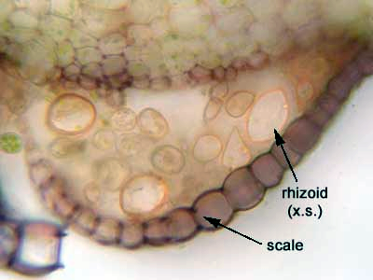
A ventral epidermis is present on the underside of the thallus, from which can emerge colorless rhizoids and scales. The rhizoids present can either pegged or smooth.
Pegged rhizoids are thought to be involved in water transport, whereas the smooth rhizoids aid in fixing the thallus to the substrate and are often considered a gateway for endophytic fungi.
The ventral unistratose scales are typically arranged in one or two rows and are thought to function in water retention and conduction.
A ventral epidermis with colorless rhizoids and scales

Slide 19
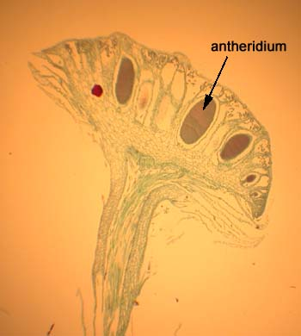
The gametophyte of the species in this class can either be monoecious or dioecious.
The antheridia can be found in chambers that opens to the upper surface of the thallus.
In some genera, the antheridia are present on a specialized structure that extends from the gametophyte called the antheridiophore, as seen in this picture.
The antheridia are located at the top of the disk and the sperm is dispersed via rain drops.

Slide 20
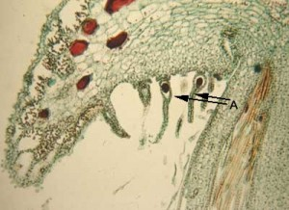
The archegonia can be found embedded in the thallus or elevated on umbrella-like called archegoniophores, as in Marchantia. The location of the archegonia differs from that of the antheridia, such that they are typically found on the margin of the archegoniophore.
Furthermore, as the archegonia mature, the upper portion of the archegoniophore grows more than the lower portion and as a result, the archegonia are transferred to the lower surface(the archegonia in the following picture are labeled).
A - archegonia
However, it is important to keep in mind that the morphology of the male and female reproductive structures can vary considerably in this class. However, the locomotive and biflagellate sperm is a distinctive trait that all species in this class share.

Slide 21
Asexual reproduction can be achieved by various ways depending on the species. In Marchantia, gemmae develop inside a cup-like structure on the surface of the thallus.
Bifurcation, which is the splitting of the main thallus in two, is another means of asexual reproduction. This process is followed by the decay of the older posterior regions of the thallus, thus allowing the species to colonize nearby areas rapidly.

Slide 22
Class Marchantiopsida
Subclass Marchantiidae
Order Marchantiales
Family Marchantiaceae
Genus Marchantia
Marchantia polymorpha, sometimes known as the common liverwort or umbrella liverwort, is a large liverwort with a wide distribution around the world. It is variable in appearance and has several subspecies. It is delicious, having separate male and female plants.

Slide 23
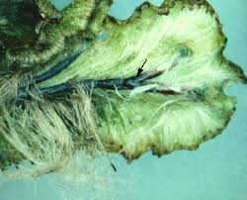
External Features of Gametophyte of Marchantia:
The plant body is gametophytic, thalloid, flat, prostrate, plagiotropic, 2-10 cm. long and dichotomously branched.
On the dorsal surface there is dark green colored mid rib.
• The mid rib bears gamma cup for asexual reproduction
• The ventral surface consists of unicellular, tubular, colorless structures called rhizoids and multicellular plate like violet in color structures are present called scales.
• The rhizoids absorb water. They are of two types
1. Smooth rhizoids which are thin walled.
2. Tuberculate rhizoids which are thick walled
Thallus of
Marchantia
Rhizoids of
Marchantia

Slide 24
The scales protect from the injuries to the thallus and transport water. The scales are simple and complex.
At the apex of the thallus there is apical notch.
The male and female plants are found separately i.e. dioecuious. In male plant male sex organs, Antheridia are produced and in Female plant female sex organs, Archegonia are produced.
Internal structure
On the dorsal and ventral surface of the thallus outermost single layered epidermis is present.
The upper epidermis consists of air pores. The air chambers are present below upper epidermis. The air chambers are separated by partition walls.
In air chamber there are photosynthetic filaments which are made up of cells which are rich in chloroplast where food is synthesized. It is synthesizing zone.
Below synthesizing zone, there is a region of compactly arranged paranchymatous cells, which are thin, walled that store food. It is storage zone.
Lower epidermis consists of number of rhizoids and scales.

Slide 25
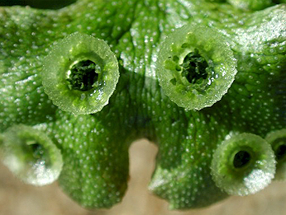
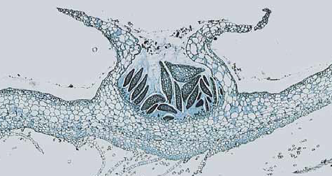
Vegetative Reproduction:
In Marchantia it is quite common and takes place by the following methods:
By Gemmae:
The cup like structures is found on the midrib of dorsal surface. Within gemma cup small stalked structures are formed called gammae.
The gammae are asexual reproductive structures, which are made up of parenchymatous cells. The cells of the gammae are filled with chloroplast. When the gemmae fall on the ground, they produce new plant body.
Gemma cup of Marchantia
Longitudinal section of a gemma cup. The gemmae are the dark structures.

Slide 26
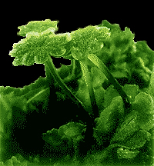
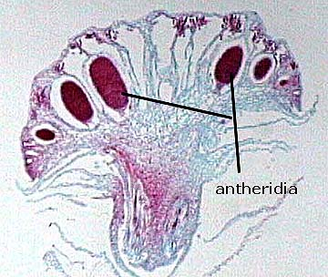
Sexual Reproduction
The Marchantia is dioecious or heterothallic i.e. male and female sex organs are found in separate individual. The sexual reproduction takes place by fusion of male and female gamete.
Male gametophyte
The male gametes are called antherozoids. Each antherozoid is elongated, coiled, and flagellated. Anhterozoids are formed within antheridium (male sex organ). Each antheridium is globular with short stalked and jacket layer encloses numerous cells called androcytes.
Each androcytes forms antherozoids when antheridium gets ruptured and antherozoids liberate out. The antheridia are fond on the upper surface of the receptacle of antheridiophore.
Each anteridium is embedded in a cavity. The cavity opens outside through a pore called ostiole. The antherozoids come out through ostiole and swim in water.
Antheridium of Marchantia

Slide 27
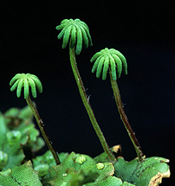
Female gametophyte The female plant bears archegoniophore. It is 5-7 cm long. It consists of stalked and star like female receptacle. Usually receptacle has nine rays of star like structure.
Numerous female sex organs called archegonia are hanging in lower part of female receptacle.
Archegoniophore of Marchantia.

Slide 28
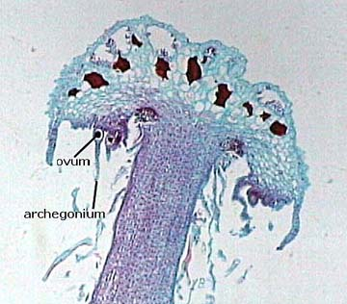
Archegonia consists of swollen basal portion called venter and elongated neck.
The Venter consists of a prominent cell called egg. Near egg, there is another cell and Venter canal cell. Cell in the neck are called neck canal cell.
Archegonia
venter
egg
neck canal cell
Archegoniophore of Marchantia.

Slide 29
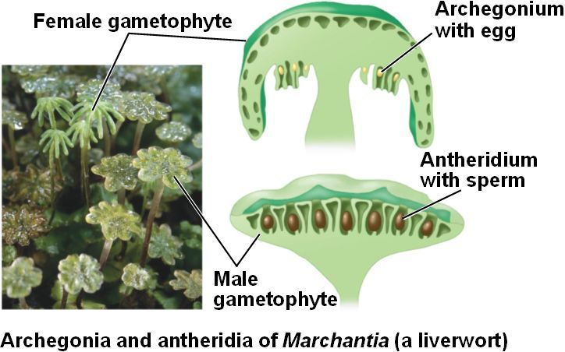
Fertilization
Swimming antherozoid reach to the archegonia tip with the help of water. Neck canal cell of archegonia gets dissolved. A kind of mucilage is secreted by dissolving neck canal cells and reaches to the venter canal cell and gets fused with egg and zygote is formed.

Slide 30
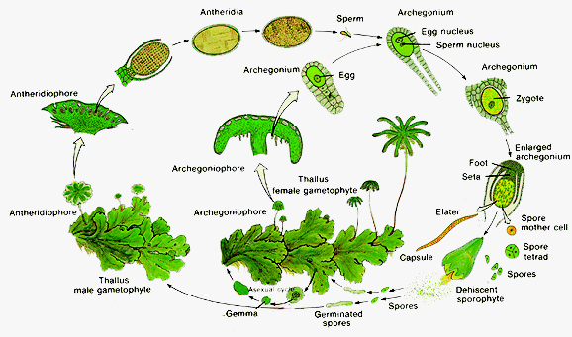
Liverwort Life Cycle: The life cycle of a typical liverwort follows the pattern of alternation of generations.
Spores are released from sporophytes and form the gametophyte.
Male gametes fertilize female gametes to form a zygote, which grows into a sporophyte.
This sporophyte disperses spores with the help of elaters; the process begins again.
Liverwort Life Cycle

Slide 31
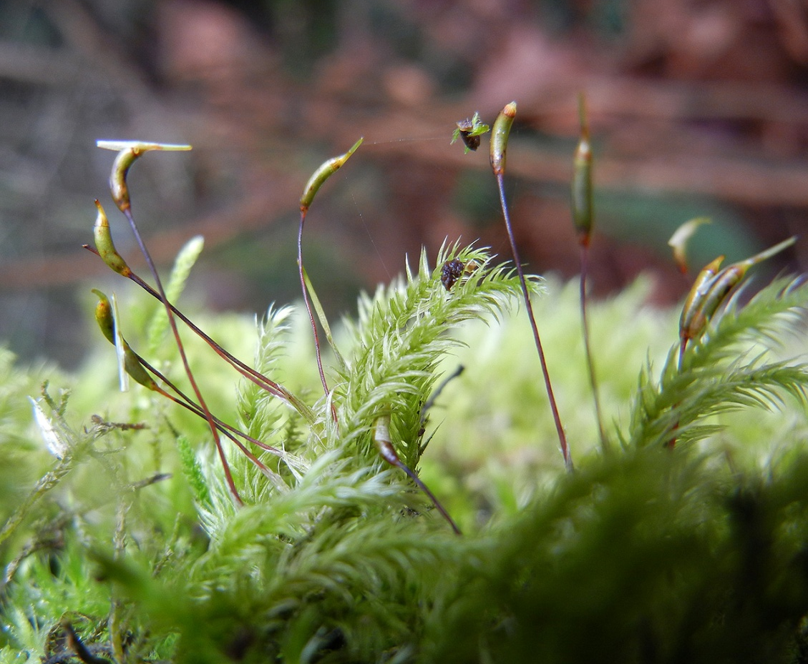
Phylum Bryophyta
Mosses (Phylum Bryophyta) may be found all around the world and inhabit diverse habitats. Habitats range from exposed rock types, shaded coniferous forests, to bogs.
Mosses can be distinguished from liverworts (Phylum Marchantiophyta) and hornworts (Phylum Anthocerotophyta) by a number of gametophytic and sporophytic features.
The gametophytic generation of mosses is characterized by its organization and morphology of its tissue. Much like tracheophytes (vascular plants), mosses have leaves. Leaves are unistratose and radially arranged around a stem.

Slide 32
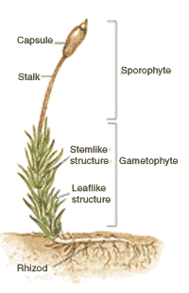
Species can be distinguished by means of the features of their leaves.
A commonality to leaves is the presence of chloroplasts, and lack of oil bodies. The conducting tissues of Bryophyta are not lignified, thus are not tracheophytes. Nevertheless, mosses contain conducting tissues known as hydroids, for water transport.
Mosses rarely contain lentoids, these cells are responsible for nutrient conduction. Hydroids and leptoids may be found in the stem or leaves, depending on the species.
The structure of a typical moss plant

Slide 33
The sporophytic generation is more complex than liverworts and hornworts and generally defines the phylum. Growth of the sporophyte is determinate and there are three main parts of the sporophyte known as the foot, seta, and sporangium.
The seta supports and elevates the sporangium to aid in spore dispersal.
The calyptra, a protective tissue around the sporangium arising from the ventor of the archegonium, expands after seta elongation and falls off the sporangium when the sporangium is mature.

Slide 34
The spores are released when the sporangium is mature and typically dry.
An operculum, at the apex of the sporangium, falls off to expose peristome teeth that aid in the dispersal of spores.
Peristome teeth arrangement and morphology aid in distinguishing certain taxonomic categories.
Finally, stomata are typically present on the walls of the sporangium. Stomata aid in gas exchange and are also found on tracheophytes.

Slide 35
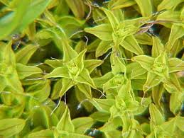
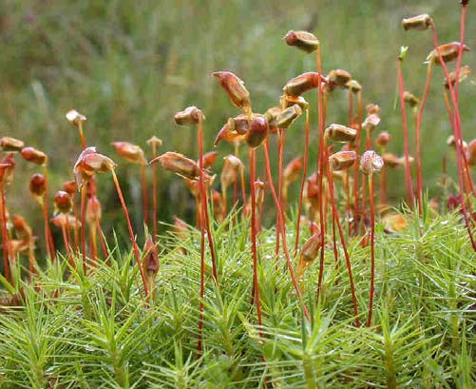
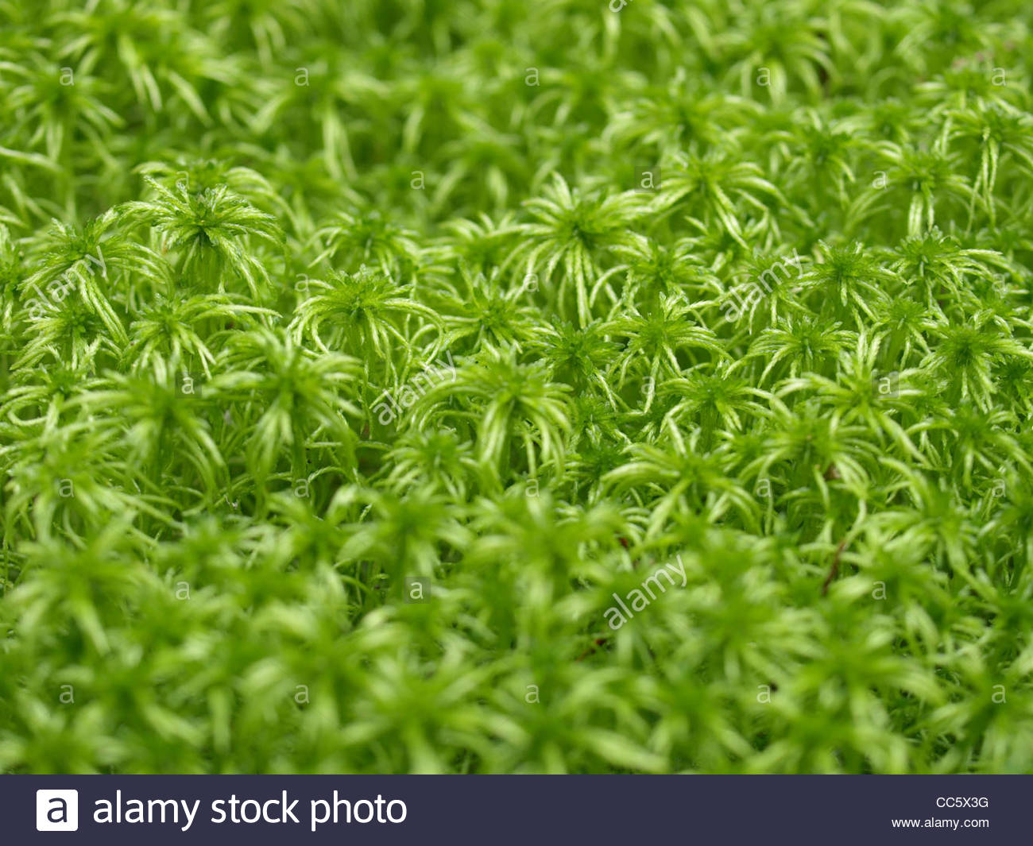
MOSS CLASSIFICATION
In the 2000 classification scheme the phylum Bryophyta is divided into six classes: Takakiopsida, Sphagnopsida, Andreaeopsida, Andreaeobryopsida, Polytrichopsida and Bryopsida.
The most important are Sphagnopsida - peat mosses, Polytrichopsida—hair cap mosses, and Bryopsida—green mosses.
Bryopsida
Polytrichum
Sphagnum

Slide 36
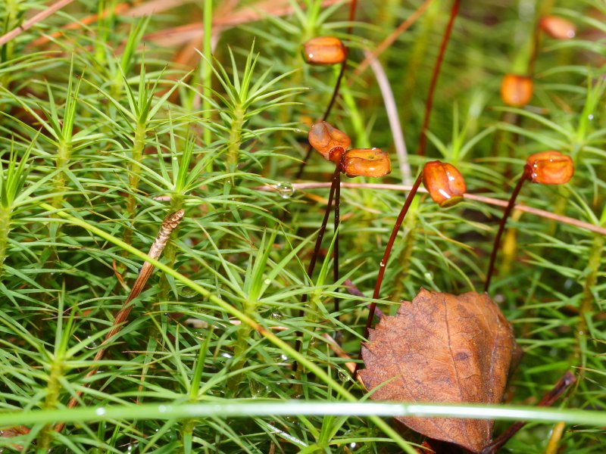
Class Polytrichopsida
Order Polytrichales
Family Polytrichaceae
Genus Polytrichum
Polytrichum commune is dark green in colour, but becomes brownish with age. The stems can occur in either loose or quite dense tufts, often forming extensive colonies.
The stems are most typically found at lengths of 5 to 10 cm, but can be as short as 2 cm or as long as 70 cm.
They range from erect to decumbent (i.e. reclining) and are usually unbranched. The leaves occur densely to rather distantly, and bracts are present proximally.
The reddish brown or dark green phyllids (leaves), often 12 mm long, have sheathed bases and pointed tips.
Polytrichum commune

Slide 37
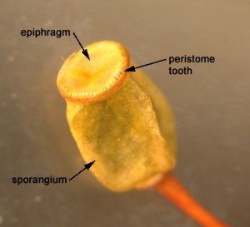
Male and female reproductive organs are borne on separate plants. The top of the male shoot forms a flowerlike structure each year, and elongation of the shoot results in a series of “flowers” over a period of several years.
The sporophyte terminates in an expanded sporangium (capsule), a specialized organ where meiosis occurs, producing spores. The capsules of Polytrichum commune are box shaped.
Most moss sporangia have teeth-like structures, called peristome teeth, (hygroscopic, opening and closing depending on atmospheric moisture), effecting spore dispersal in the process.
Each sporangium has a light-brown, hoodlike covering (calyptra) with long hairs covering its surface.
Capsule of Polytrichum commune

Slide 38
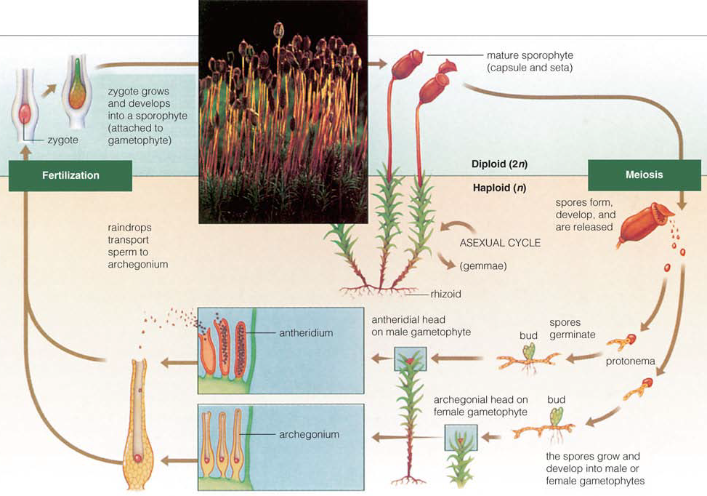
Life cycle: The alternation of generations cycle begins when the gametophyte germinates from a haploid spore and forms a protonema. Apical meristem-like cells divide and give rise to the gametophores.
The archegonium (female organ) and antheridium (male organ) develop on separate gametophores.
After fertilization, the zygote divides and grows into a sporophyte, which stays attached to the gametophyte. Spores released from the sporophyte germinate and produce gametophytes; the process begins again.
Life cycle of Polytrichum commune

Slide 39
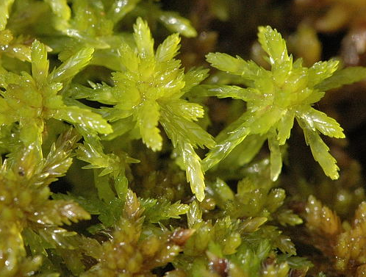
Class Sphagnopsida (Peat Mosses)
Order Sphagnales
Family Sphagnaceae
Genus Sphagnum
Sphagnum sp. (Peat Moss)
Sphagnum is best known because of its formation of peat and use in horticulture. The class Sphagnopsida is distinguished by leaves that are one cell thick and mostly possessing two types of cells – photosynthetic cells that possess chloroplasts and that form a network arrangement, and hyaline (colorless) cells that are dead at maturity, have one or more pores (giving access to the environment), and hold water.
Sphagnum sp.

Slide 40
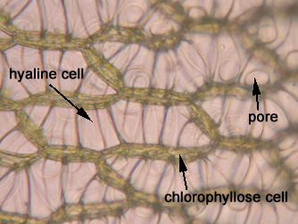
These hyaline cells form transparent patches among the network formed by the photosynthetic cells and may be equal in height to those cells or may surround them. This arrangement seems to correlate well with the ability to avoid desiccation because the hyaline cells provide a reservoir of water to the photosynthetic cells.
Those species typically occupying drier habitats generally have more of the hyaline cell surrounding the photosynthetic cell. These hyaline cells are usually strengthened by bar-like thickenings in the cell walls, making them look superficially like many cells instead of the single long cell that they are. These leaves never possess a costa (moss version of a midrib).
Sphagnum leaf, showing the chlorophyllous cells and hyaline cells

Slide 41
Mosses Have Significant Economic and Ecological Value
Sphagnum, a large genus of peat mosses, is by far the most economically important bryophyte. Because of their special epidermal cells, Sphagnum mosses are frequently added to potting soil to increase its water-holding capacity. Tons of Sphagnum are harvested throughout the world and then sold in the nursery industry in many countries.
During World War I, Sphagnum was used on a large scale as a wound dressing because its acidic sterile tissue acts as both an antiseptic and an absorbent.
In some cold-temperate areas, Sphagnum and other mosses accumulate as a thick, compacted, semi-decomposed layer atop the mineral soil. This deposit, called peat, can be cut out in blocks, dried, and burned as fuel for cooking and heating. On a much larger scale, the Rhode generating station in Ireland burns 2,000 metric tons of peat a day to produce electricity.

Slide 42
Ecologically, bryophytes are important as colonizers of bare rock and sand. Their small bodies trap dust and wind-blown silt, building soil. Mosses create stabilizing soil crusts in such inhospitable places as coastal dunes and inland deserts. Some bryophytes harbor symbiotic nitrogen-fixing cyanobacteria and significantly increase the amount of nitrogen available to the biosphere. In tundra vegetation, bryophytes constitute as much as 50% of the aboveground biomass, and they are an important component of the food chain that supports animals within the ecosystem. Temperate and cold-temperate forests also have significant amounts of moss biomass.
Bryophytes also are important as tools to improve our basic understanding of fundamental biological processes. Scientists have come to recognize mosses in particular as excellent experimental plants. They are easy to propagate, to grow in small spaces, to clone into genetically identical replicates, and to observe for growth and developmental changes. Because gametophytes are haploid, mutations that would be recessive in diploid cells are expressed. Many discoveries about moss genetics, tissue development, and ecology in the past several decades have proved widely applicable to land plants in general.

Slide 43
Pteridophyta: the ferns
Pteridophyta, ferns and allies, have approximately 12,000 species and six classes.
They have a sporic life cycle with sporophyte predominance whereas their gametophytes are often reduced to prothallium, small hornwort-like plant. Another frequent variant is the underground, mycoparasitic gametophyte.

Slide 44
Pteridophyta (with one exception) have true roots.
Most of them have vascular tissues and are homoiohydric. This is why seed plants together with ferns have a name vascular plants.
Pteridophyta sporophytes always start their life from an embryo located on the gametophyte. While Pteridophyta have true xylem and phloem, they do not have developed secondary thickening.
Most ancient pteridophytes appeared in Silurian period, they were rhyniophytes. Rhyniophyles had well-developed aboveground gametophytes and relatively short, dichotomously branched leafless sporophytes. The next important steps were formation of leaves and further reduction of gametophytes

Slide 45
Diversity of Pteridophytes
Phylum of Lycopodiophyta consist of two separate class:
Lycopodiopsida
Polypodiopsida
Class Lycopodiopsida
Order Lycopodiales
Family Lycopodiaceae
Genus Lycopodium
Order Selaginellales
Family Selaginellaceae
Genus Selaginella
Order Isoetales
Family Isoetaceae
Genus Isoetes

Slide 46
Class Lycopodiopsida, or lycophytes have at least four genera and more than 1,200 species. Lycophytes belong to microphyllous lineage of pteridophytes. This means that their leaves originated from the emergences of the stem surface, and therefore are more similar to moss leaves than any other leaves of pteridophytes and seed plants.
Lycophyte sporangia are associated with leaves and often form strobilus which is condensation of sporangia-bearing leaves (sporophylls when they are leaf-like or sporangiophores when they are divergent).
Their spermatozoon usually has 2 flagella (like mosses) but are sometimes also multiflagellate (like spermatozoa of other ferns). Lycophytes used to be the dominant plants of Carboniferous tropical swamp forests and their remains became coal. Contemporary lycophytes are much smaller but still thrive in wet and warm places.
More basal lycophytes (clubmoss Lycopodium) have equal spores and underground gametophytes, whereas more advanced Selaginella (spikemoss) and Isoëtes (quillwort) are both heterosporous with reduced aboveground gametophytes.

Slide 47
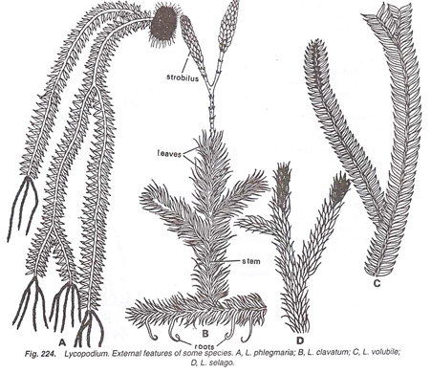
Lycopodium
Lycopodium is commonly known as ‘club moss’ due to their moss like appearance and club shaped strobili.
Plant body is sporophytic and the sporophyte is divisible into roots, stem and leaves. Usually they may have either prostrate stem with erect leafy branches or weak pendant stem (epiphytes).
Lycopodium. External features of some species: A.- L. phlegmaria, B – L. clavatum, C – L. volubile, D – L. selago

Slide 48
Stem is erect, pendant or prostrate with upright branches. The branching of the stem is partly monopodial and partly dichotomous. The stem is thickly covered with many leaves.
Leaves are eligulate, simple, small, sessile, usually lanceolate in outline with broad base. Each leaf contains a single unbranched midvein. Leaves are arranged spirally in Lycopodium clavatum and Lycopodium annotinum, in pairs in Lycopodium alpinum, and in whorls in Lycopodium cernuum. Leaves contain many equally distributed stomata.
Roots are adventitious, dichotomously branched and small.

Slide 49
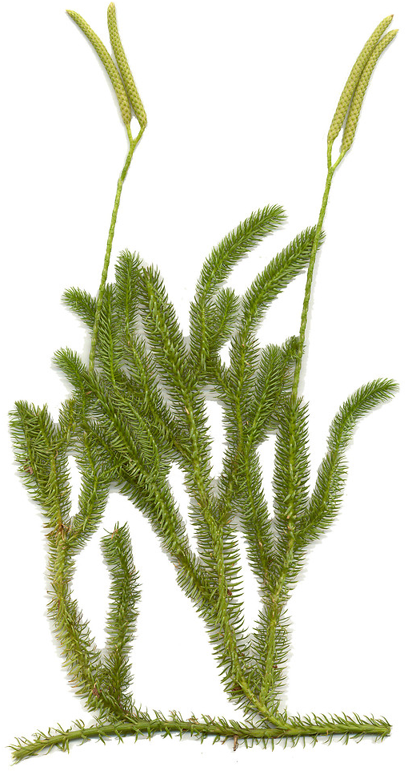
Lycopodium clavatum
The sporophyte has a weak, prostrate stem trailing along the surface and rooted down with adventitious roots growing anywhere on the lower surface. The branching is dichotomous becoming monopodial by the strong development of aerial branches here and there. The stem is closely covered spirally by small, simple (microphyllous), sessile, lanceolate leaves with mildly serrate margins and single median veins.
The strobilus is at the apex of the stem. The sporophylles look all alike and are arranged in a compact spiral. In most cases the sporangia, like in Lycopodium, which produce identical spores, are formed on the sporophylle. This phenomenon is called homospory. These spores grow into the gametophyte on which antheridia and archegonia are formed.

Slide 50
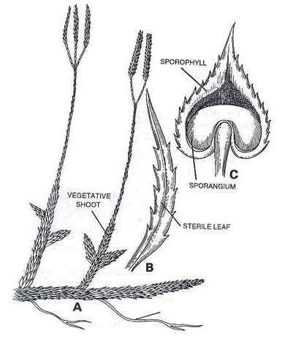
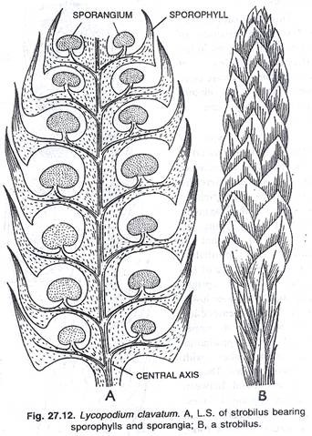
Lycopodium sp., A - strobilus bearing sporophylls
and sporangia, B - strobilus
Lycopodium sp., A - shoot bearing strobili, B – sterile leaf, C – sporophyll with sporangium

Slide 51
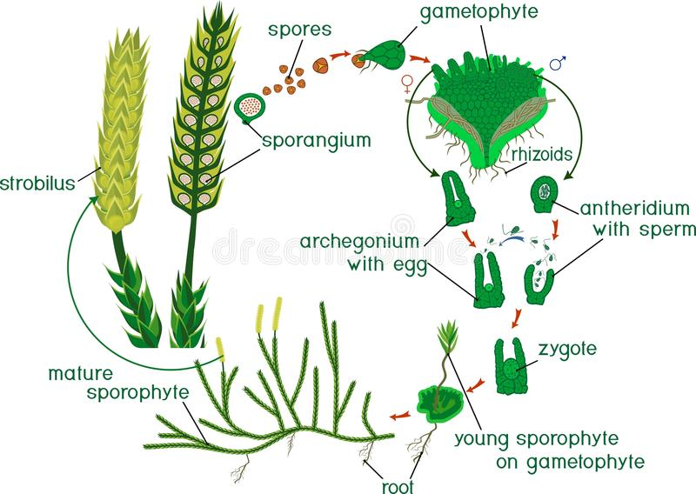
Steps in Life cycle of Lycopodium
Lycopodium plant body is sporophyte (2n)
Strobilus or cone is the spore bearing structure
In Strobilus diploid spore mother cells undergo meiosis forming haploid spores (1 n)
Spores germinate forming gametophyte or protallius (Monoecious: both antheridia and archegonia are present)
Antheridium produce sperms. Sperms are multiflagellate. Archegonium produce egg.
Fertilization is oogamous.
Zygote divides to form Embryonic sporophyte later form mature plant body (Diploid Lycopodium sporophyte)

Slide 52
Asexual reproduction
Lycopodium branch out and expand through rhizomes, which are actually branches that stretch out and creep along over or under the soil, which seek out new areas of the soil to root and live. Rhizomes form roots, called adventitious roots, which when they send vertical shoots above ground, are the asexually reproducing generations of the lycopodium. New shoots can be formed from rhizomes coming directly out of the sporophyte.

Slide 53
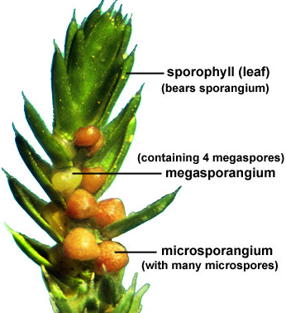
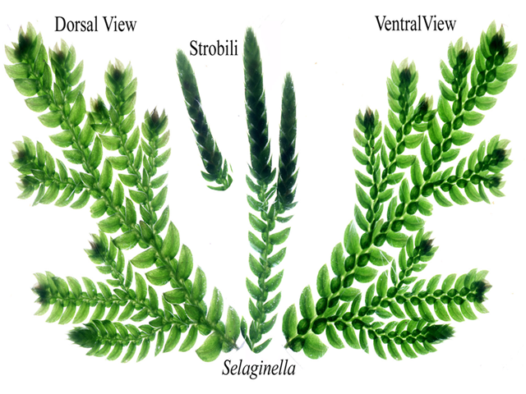
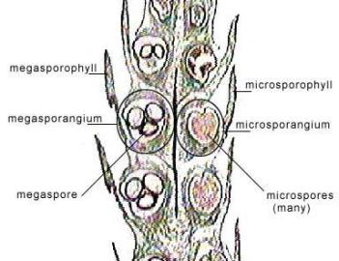
Also heterospory occurs in the Lycophyta, for example in Selaginella. Two types of sporangia develop on the sporophylls: macrosporangia (female sporangia) on the lower sporophylls and microsporangia (male sporangia) on the upper sporophylls. The sporangia are located in the so-called ligula, which are small lingular, chlorophyll-lacking scale at the upper side of the base of the sporophylls.
Selaginella: plant body, strobilus
Strobilus of Selaginella sp.

Slide 54
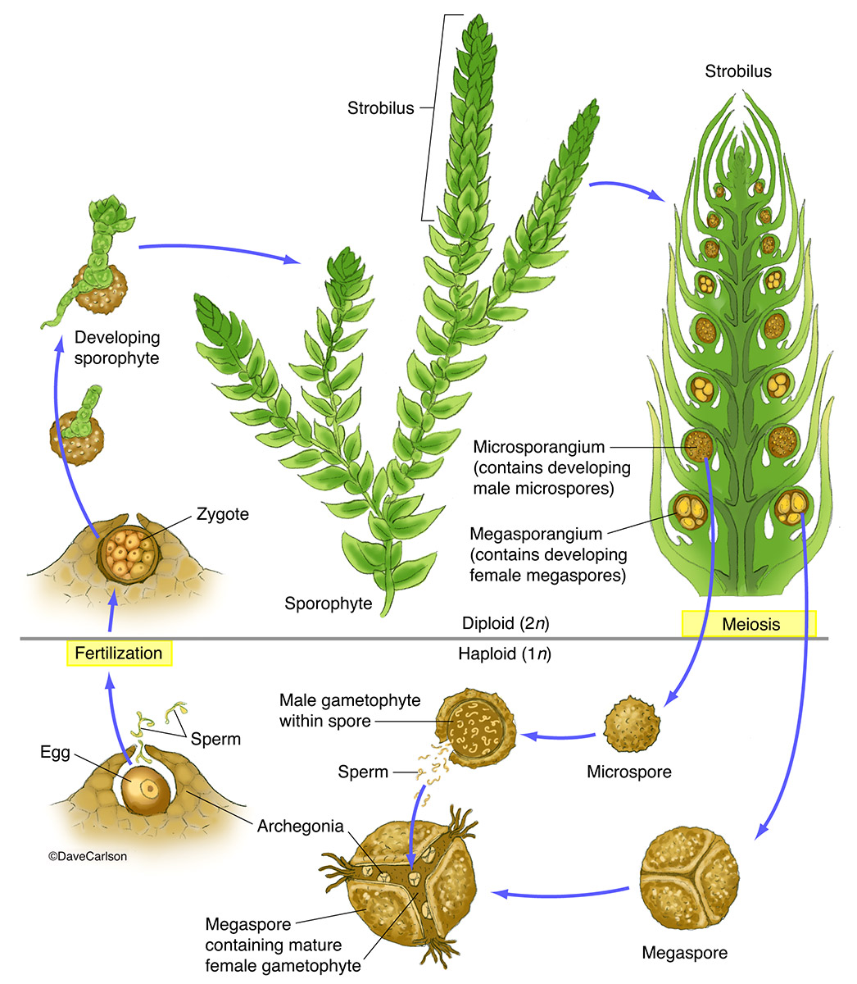
The prothallium is club-shaped. The development of the microprothallium begins already at the stage that the microspore is still located inside the microsporangium. The entire process is completed within the compartment of the spore. This is also true for the early development of the macroprothallium, but eventually the wall of the spore disrupts while rhizoids and the archegonia with egg cell continue to grow.
Life cycle of Selaginella

Slide 55
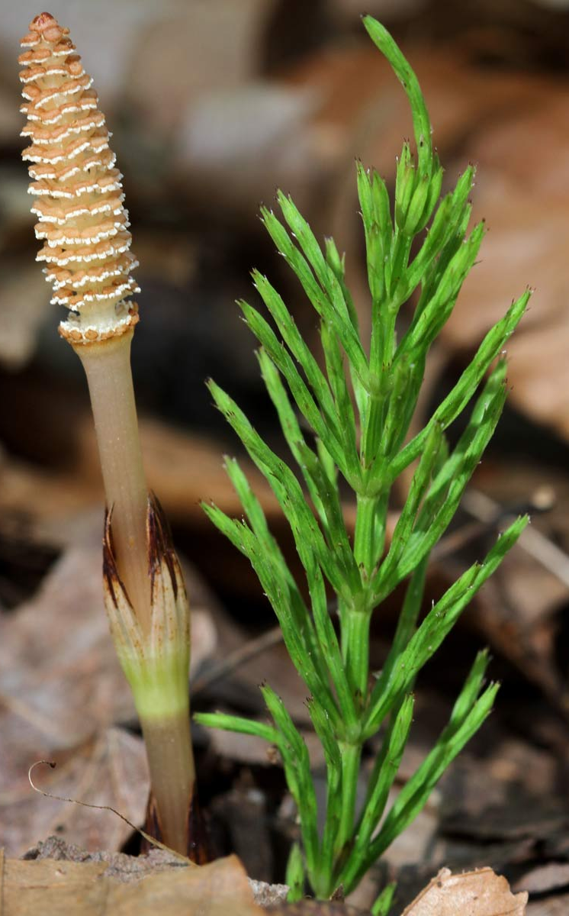
Phylum Equisetophyta
Class Equisetopsida
Order Equisetales
Family Equisetaceae – Horsetail family
Genus Equisetum
Class Equisetopsida (horsetails) is a small group with one genus, Equisetum, and has about 30 different herbaceous species that typically live in moist habitats. The leaves of these plants are reduced into scales, and the stems are segmented and also photosynthetic; there is also an underground rhizome. The stem epidermis contains silica which makes it have an abrasive surface. The stem has multiple canals, this is somehow similar to stems of grasses. The sporangia are associated with hexangular stalked sporangiophores; there are also elaters which are not separate cells but parts of the spore wall.
Equisetum
Gametophytes are typically minute and dioecious, but the plants themselves are homosporous: smaller suppressed gametophytes develop only antheridia while larger gametophytes develop only archegonia.

Slide 56
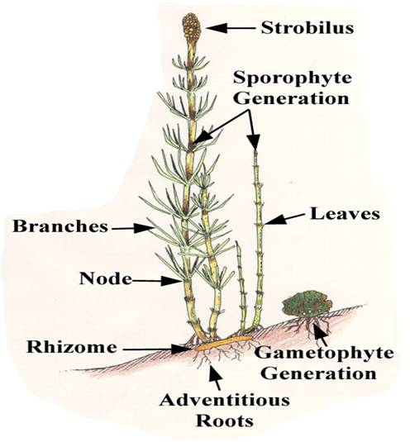
Genus Equisetum
The sporophytic plant body of Equisetum is differentiated into stem, roots and leaves.
The stem of Equisetum has two parts: perennial, underground, much-branched rhizome and an erect, usually annual aerial shoot. The branching is monopodial, shoots are differentiated into nodes and internodes.
Some shoots are profusely branched, green (chlorophyllous) and purely vegetative. The others are fertile, unbranched, brownish in colour (achlorophyllous) and have terminal strobili. The underground rhizome and the aerial axis appear to be articulated or jointed due to the presence of distinct nodes and internodes. Externally, the internodes have longitudinal ridges and furrows and, internally, they are hollow, tube-like structures. The ridges of the successive internodes alternate with each other and the leaves are normally of the same number as the ridges on the stem.
Equisetum plantbody

Slide 57
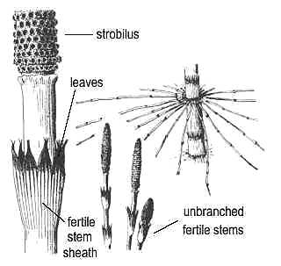
Leaves:
The leaves of Equisetum are small, simple, scale-like and isophyllous; they are attached at each node, united at least for a part of the length and thus form a sheath around the stem. The sheath has free and pointed teeth-like tips. The number of leaves at a node corresponds to the number of ridges on the internode below. The leaves do not perform any photosynthetic function and their main function is to provide protection to young buds at the node.

Slide 58
Spores are produced within the sporangia. The sporangia are borne on the sporangiophores which are aggregated into a compact structure termed strobilus or cone or sporangiferous spike.
The strobilus is composed of an axis with whorls of sporangiophores. Each sporangiophore is a stalked structure bearing a hexagonal peltate disc at its distal end. On the under surface of the sporangiophore disc 5-10 elongate, cylindrical hanging sporangia are borne near the periphery in a ring.
Strobilus of Equisetum
At maturity, the strobilar axis elongates, as a result the sporangiophores become separated and exposed. Then the sporangium splits open by a longitudinal line due to the differential hygroscopic response of the wall cells.
Sporangiophores with sporangia

Slide 59
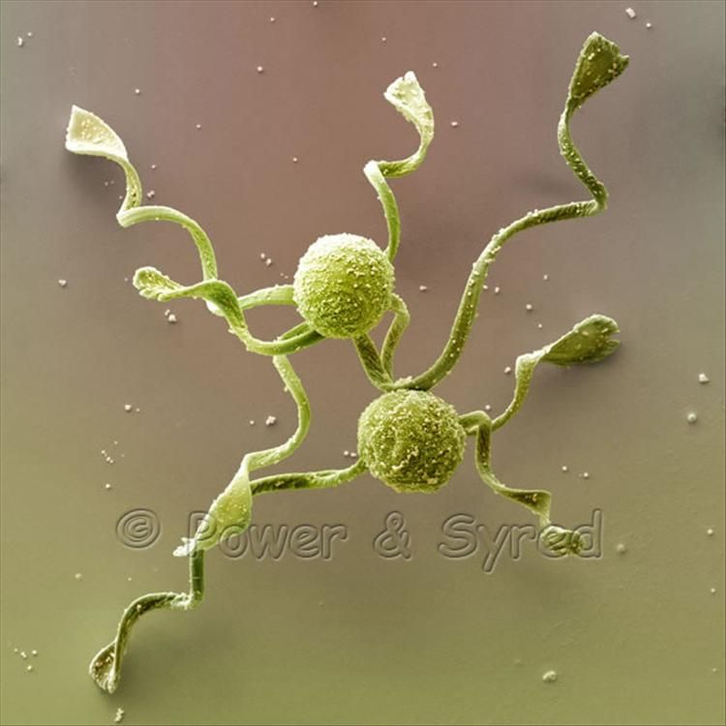
The spores are spherical and filled with densely packed chloroplasts. The spore wall is laminated and shows four concentrate layers. The innermost is the delicate intine, followed by thick exine, the middle cuticular layer and the outermost epispore or perispore. The intine (endospore) and exine (exospore) are the true walls of the spore. Equisetum spores have elaters which help to spring spores out of their sporangia once it has split open. Spores are the units of gametophytes. Spores are homosporous or haploid in nature and on germination give rise to young prothallus or gametophyte.
Equisetum: spores

Slide 60
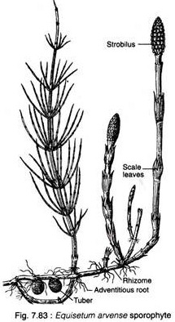
Reproduction in Equisetum:
Equisetum reproduces vegetatively and by means of spores.
Vegetative Reproduction:
The subterranean rhizomes of some species (e.g., E. telmateia, E. arvense) form tubers which, on separation from the parent plant, germinate to produce new sporophytic plants. The tubers develop due to irregular growth of some buds at the nodes of the rhizomes.

Slide 61
Spore cases form small cones on the stems of the plant. The spores themselves are dispersed by the wind. If they land in a wet or damp place, they can germinate and grow into tiny plants called gametophytes.
The gametophyte grows two different structures, one holding female gametes in tiny cups and the other holding male gametes equipped with tails to aid in movement. This phase of the
horsetail's life cycle, known as gametophyte generation, exists to ensure genetic diversity.
Horsetails rely on rain for fertilization. The arrival of rain releases the male gametes, which then swim to the cups holding the female cells. The embryos grow to form the stem-like structure that characterizes the mature horsetail.

